Slide 1
Data Visualization
Provas de Atletismo

Slide 2

WebScraping

Slide 3
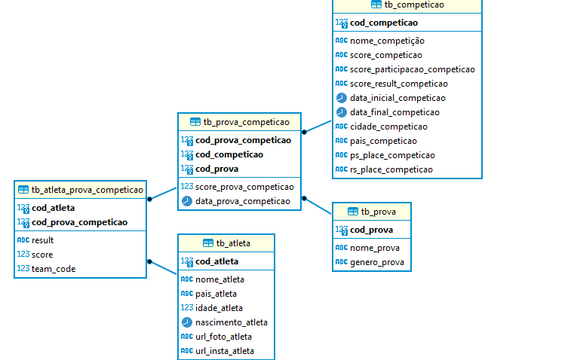
ERD

Slide 4
Exemplos
select date_part('year', C.data_prova_competicao) as dataprova, avg(cast (A."result" as float))
from db_atl.tb_prova_competicao as C, tb_atleta_prova_competicao as A, tb_prova as P where
C.cod_prova_competicao = A.cod_prova_competicao and C.cod_prova = P.cod_prova and
P.nome_prova like '%Long Jump%' and P.genero_prova like '%Men%' and date_part('year', C.data_prova_competicao) = 2010
group by dataprova
Result = 7.410704225352109 metros

